Slide 1
Medical Laboratory Science

Slide 2
When your health care provider is looking for answers, they may turn to laboratory tests.
Highly trained medical laboratory professionals sort, analyze and run tests on your samples to provide accurate results that are vital to your health care.

Slide 3
Medical Laboratory Professionals complete the picture.

Slide 4
A lot happens between giving a sample and getting results.

Slide 5
Medical Laboratory Technologist
Analyze tissue samples, blood and other body fluids as a part of the diagnostic procedure.
MLTs provide the results of these tests to physicians, allowing them to make accurate diagnosis and if needed, guide appropriate treatment.

Slide 6
Disciplines in General MLT
Clinical Chemistry Microbiology
Hematology Transfusion Science Histology

Slide 7
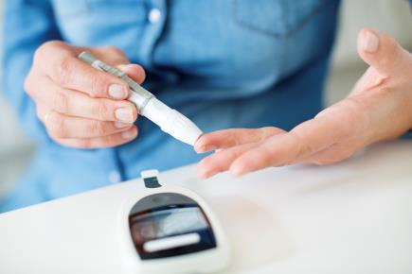
Clinical Chemistry
Determine chemistry, hormone or drug levels
Common Test: Glucose test for diabetes

Slide 8
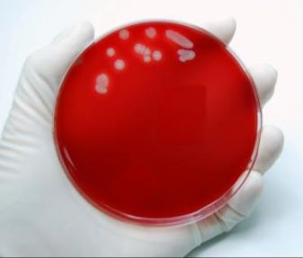
Microbiology
Bacteria, fungi, viruses and parasites
Common test: Culture and sensitivity for a throat swab

Slide 9
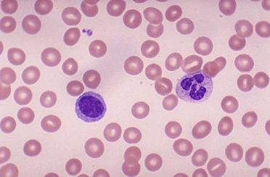
Hematology
Study of blood
Common Test: Hemoglobin test
for anemia

Slide 10
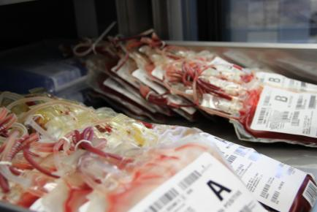
Transfusion Science
Blood typing and compatibility testing
Common test: ABO Rh and antibody screen pre-surgery

Slide 11
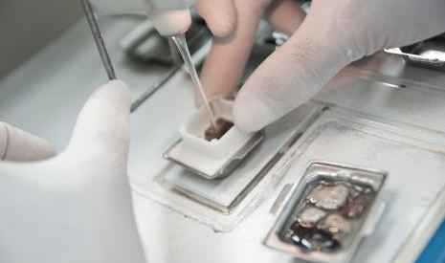
Histology
Body tissue such as, kidney, breast, and liver
Common Test: cancer diagnosis
Notes:
Histology works with body tissues directly.
-Explain the role of histologist, they type of work done and equipment used.
-Can explain the preparation of slides, analysis and stages of diagnosis, etc.
http://www.istockphoto.com/photo/histology-procedure-embedding-20832796?st=b42711a

Slide 12
The General MLT
Certified in all five disciplines
Can be focused on one or work in all departments
Notes:
Explain how the general MLT is a multi-faceted role.
Discuss your own role (if you are an MLT) and how you feel about knowing/performing in many areas of the lab.

Slide 13
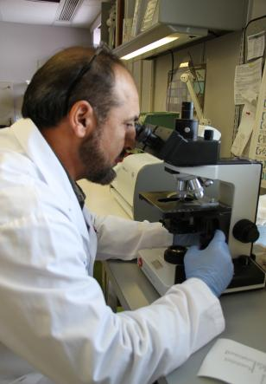
Diagnostic Cytology Technologist
Cytology technologists conduct tests on cells to detect abnormalities or cancer

Slide 14
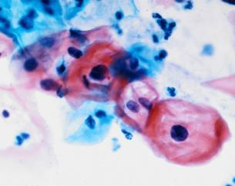
Cytology
They are able to detect pre-cancerous cells, different cancers and other cellular based infections.
An abnormal finding would be sent to a pathologist for a final diagnosis.

Slide 15
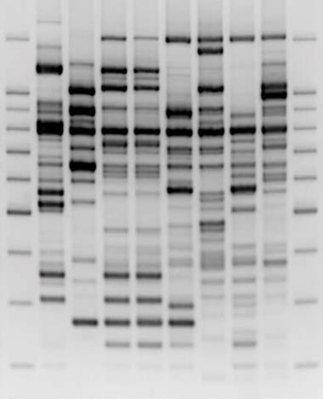
Clinical Genetics Technologists
Genetics Technologists analyze and diagnose changes or abnormalities in chromosomes and DNA, which are unique to every individual.

Slide 16
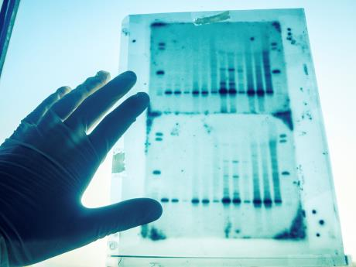
Clinical Genetics
A genetics technologist’s analysis of these cells can lead to a diagnosis of genetic diseases.

Slide 17
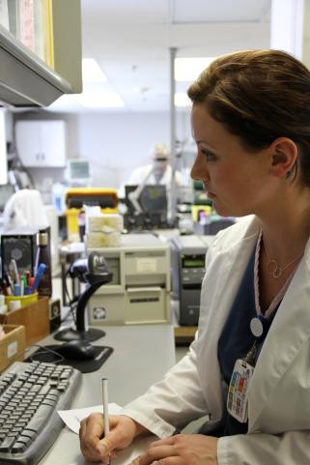
Medical Laboratory Assistant
MLAs sort, prepare and sometimes process samples that will be tested and analyzed by a MLT.

Slide 18
Medical Laboratory Assistant
MLAs collect samples and are often the laboratory professional that interacts directly with patients.

